Slide 1
Review: empirical asset pricing via machine learning
Presented by Dao Hoang Ngan

Slide 2
Agenda
Motivation
Contributions
Methods
Dataset
Evaluation
Conclusion

Slide 3
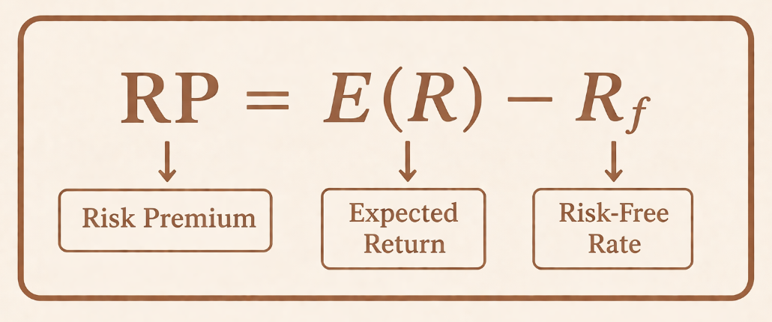

1. MOTIVATION
Measuring equity risk premiums is a central challenge in finance, particularly in settings with a large number of potential predictors and complex nonlinear relationships. Traditional linear models often struggle with model misspecification and high-dimensional data. In this context, the authors investigate whether machine learning methods can better capture these complexities, improve predictive performance, and provide more reliable estimates of risk premiums, thereby enhancing empirical asset pricing analysis.

Slide 4
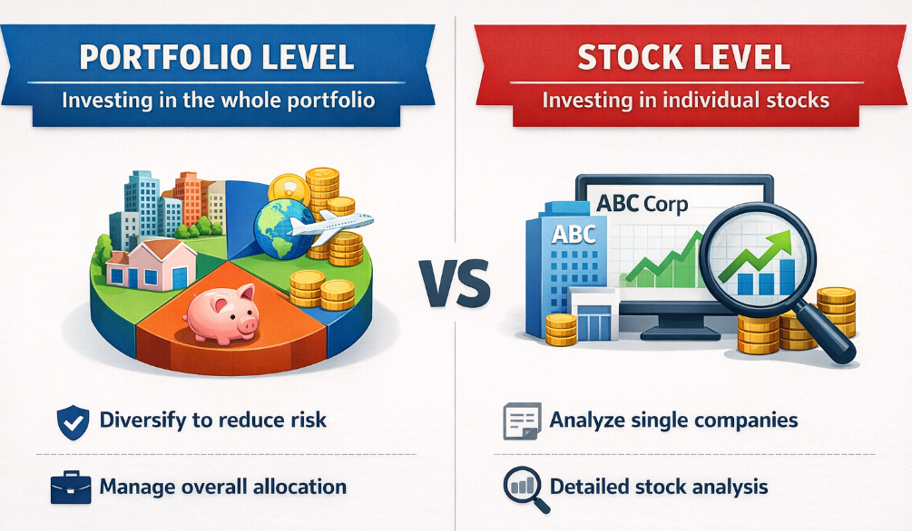
2. Contributions
New benchmarks
Create a new set of benchmarks for accuracy when using ML to predict in measuring risk premiums of the aggregate market and individual stocks
Synthesis (for stock level and portfolio level)
Provides a comparative overview of ML methods for cross-sectional and time-series return prediction, which helps clarify when and why ML is useful in financial economics

Slide 5
Machine learning definition (in this paper):
(a) A set of high-dimensional predictive models
(b) Uses regularization to prevent overfitting and select variables
(c) Employs efficient algorithms for searching among a vast number of potential model specifications
Empirical Asset Pricing via Machine Learning

Slide 6

3. Methods
Linear
OLS-3, ENet, GLM
Dimension Reduction – Linear
PLS, PCR
Non-linear
RF, GBRT, NN1–NN5

Slide 7
4. dataset
Name | Source
Monthly total individual equity returns | CRSP
Stock-level predictive characteristics | University study
Macroeconomic predictors | LinkedIn

Slide 8
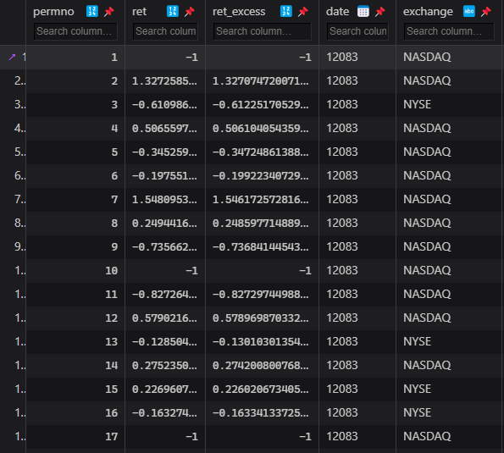
4.1. Monthly total individual equity returns
Sample Period: March 1957 – December 2016 (60 years).
The number of stocks: ~30,000 stocks in total.
Average Coverage: >6,200 stocks per month.
Target Variable: Individual stock excess returns (using Treasury-bill rate as risk-free proxy).

Slide 9
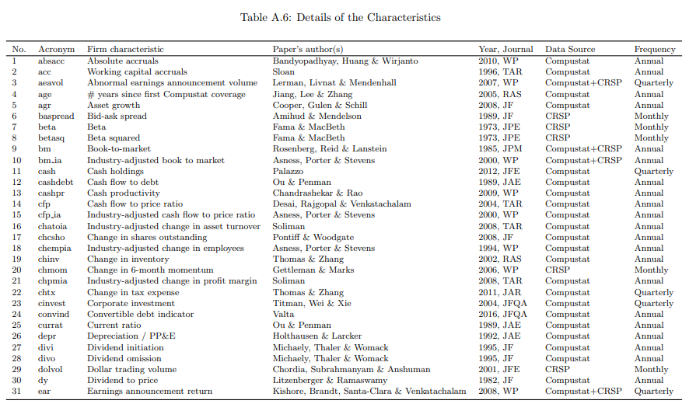
4.2. Stock-level predictive characteristics
Total Features: 94 firm-specific characteristics based on asset pricing literature. Update Frequency:
Annually: 61 variables (e.g., Fundamentals).
Quarterly: 13 variables (e.g., Earnings reports).
Monthly: 20 variables (e.g., Price momentum).
Industry Controls: 74 industry dummies (based on 2-digit SIC codes) to capture sector-specific effects. (0-1)

Slide 10
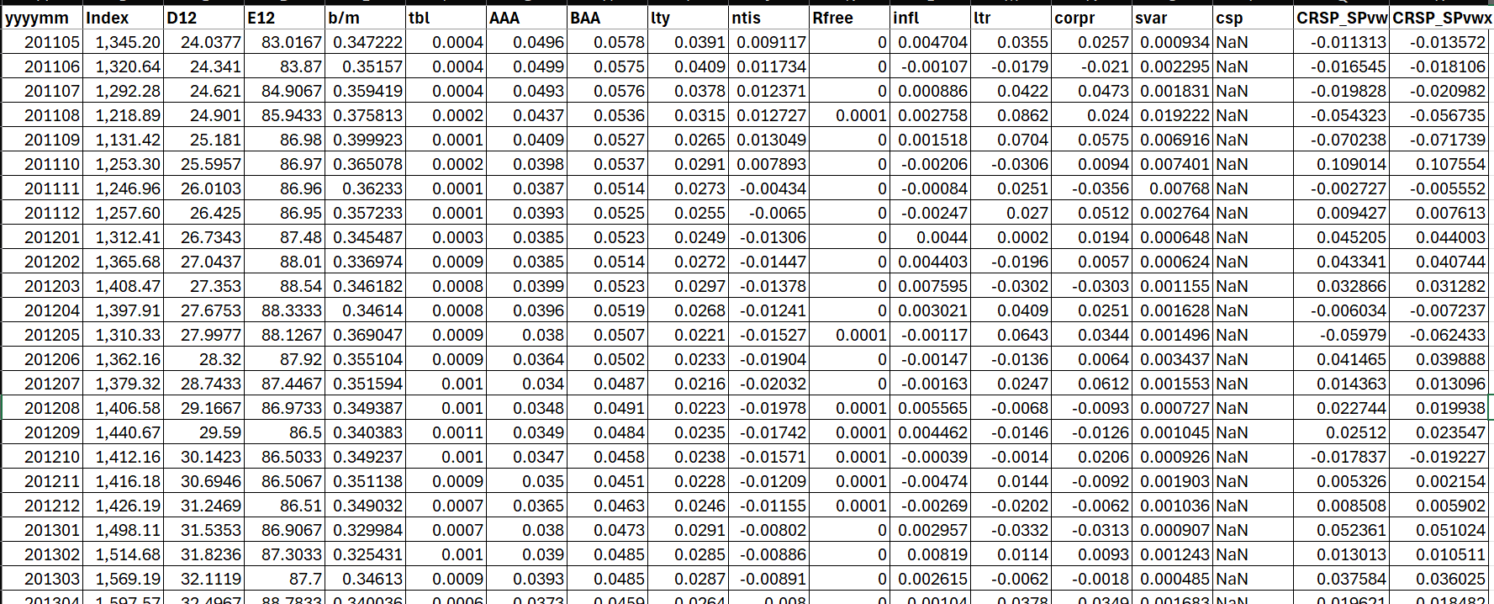
4.3. Macroeconomic predictors
8 variables following Welch & Goyal (2008):
Valuation: Dividend-price (dp), Earnings-price (ep), Book-to-market (bm).
Interest Rates: T-bill rate (tbl), Term spread (tms), Default spread (dfy).
Market: Net equity expansion (ntis), Stock variance (svar).

Slide 11
4.4. Process data
Join Characteristics Data with CRSP Data on ["permno", "month"]
Then, join the output data with Macro Data on ["month"]
Add corresponding 2-digit SIC codes
Create interactions between stock-level characteristics and macroeconomic state variables by: stock characteristic × macro variable
The total number of covariates for prediction is 94×(8+1)+74= 920

Slide 12
4. dataset
Name | Source
Monthly total individual equity returns | CRSP
Stock-level predictive characteristics | University study
Macroeconomic predictors | LinkedIn

Slide 13
5. Evaluation

Slide 14
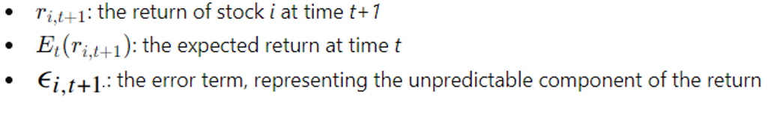


5.1. asset’s excess return as an additive prediction error model

Slide 15
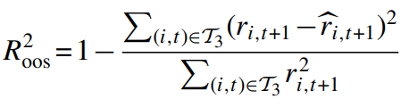

5.2. INDIVIDUAL STOCKS LEVEL
T3 indicates that fits are only assessed on the testing subsample, whose data never enter into model estimation or tuning
R²_{oos} pools prediction errors across firms and over time into a grand panel-level assessment of each model.

Slide 16
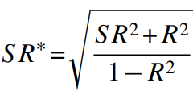
5.1. PorTfolio levels
SR: Sharpe ratio of a passive buy-and-hold investor
SR*: Sharpe ratio of an active investor exploiting ML predictive information
R²: The predictive Out-of-Sample R².

Slide 17
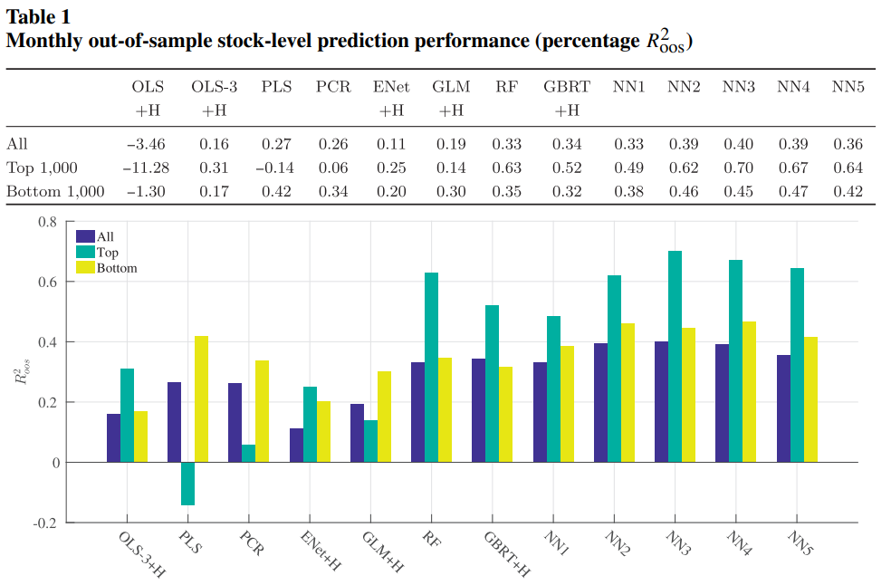
Results – stock levels

Slide 18
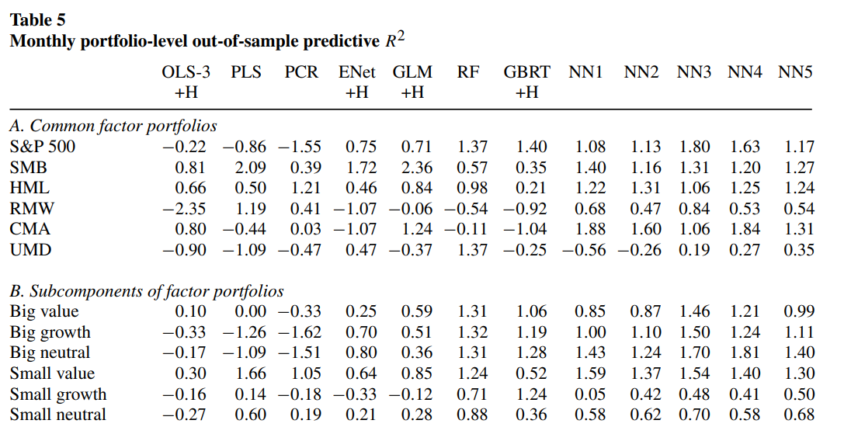
Results – PORTFOLIO levels

Slide 19


